Slide 1
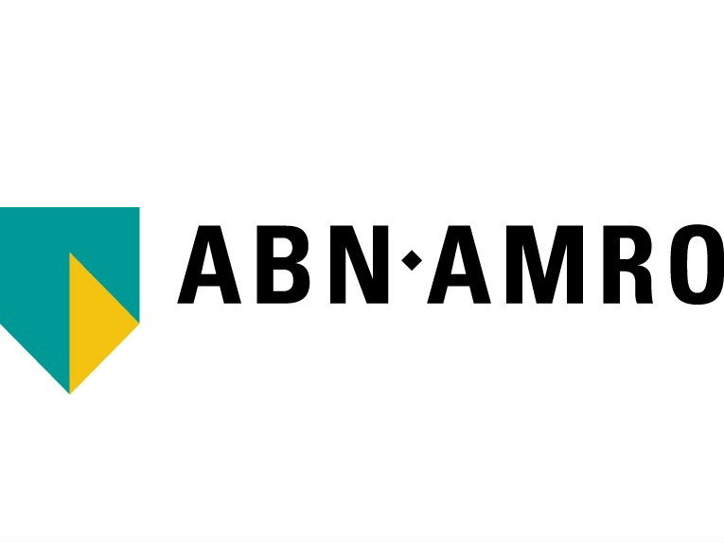
The True Price of Jeans
Commissioned by

Slide 2
Contents
Executive summary
Introduction
True Price of jeans in 2018
True Price of jeans towards 2030
Appendix
List of sources

Slide 3
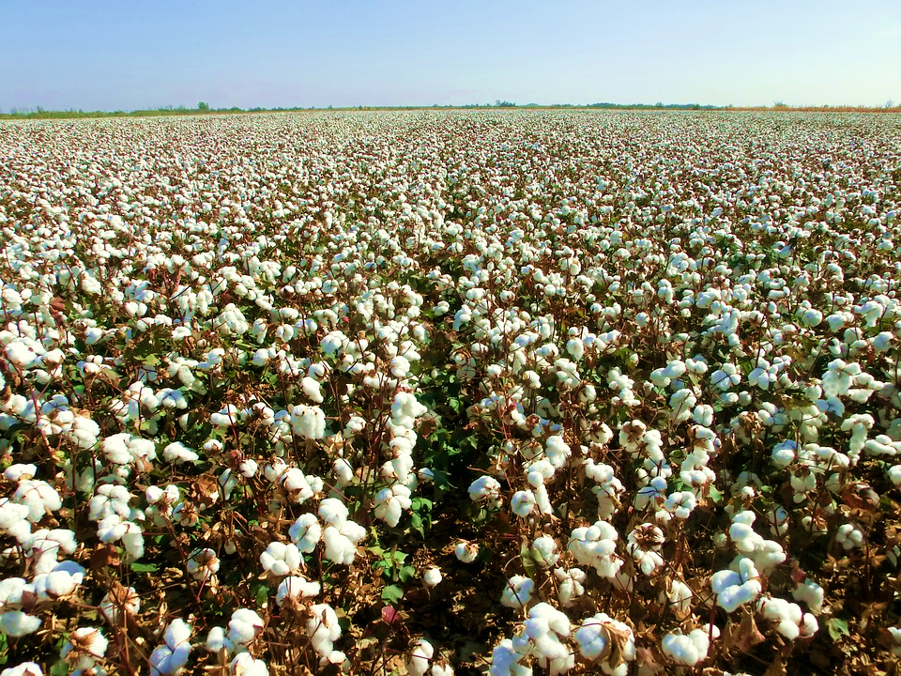
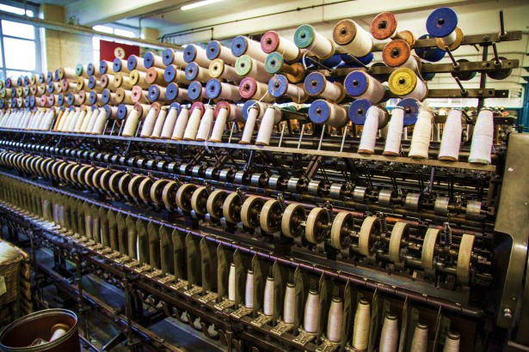
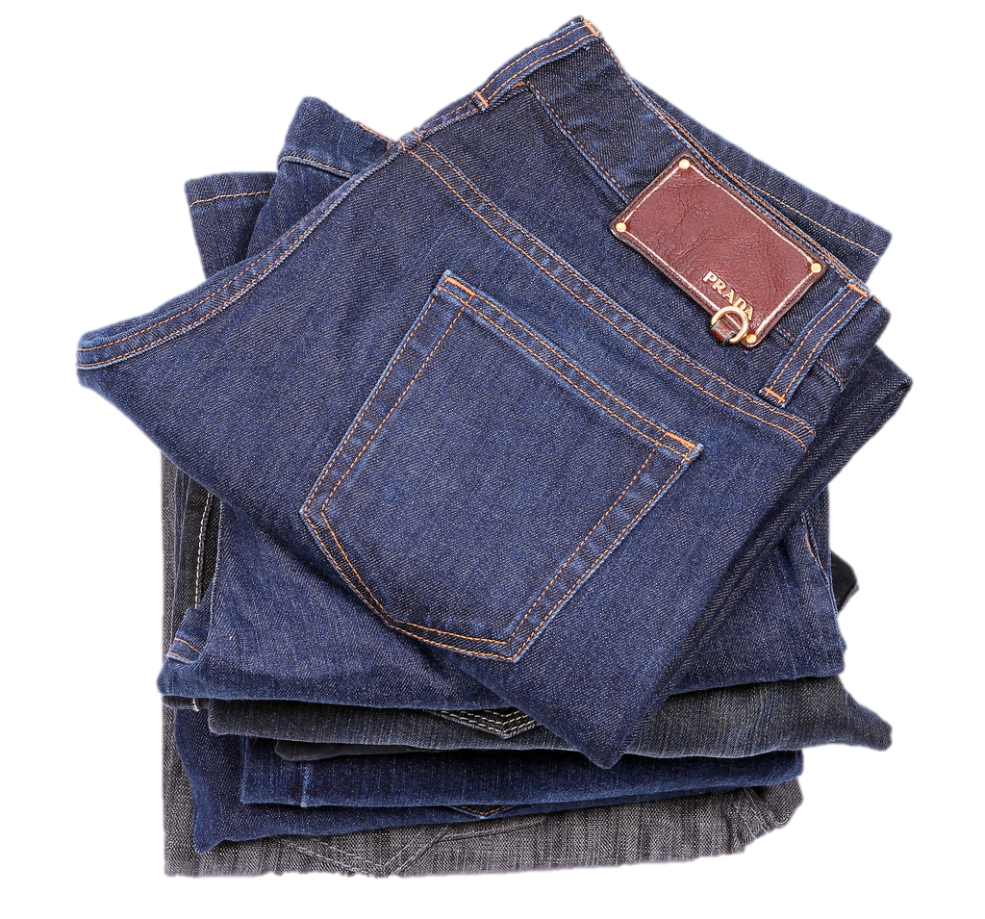
EXECUTIVE SUMMARY
True pricing can help the fashion industry’s transition to sustainability
Cotton cultivation
Denim textile production
Final product: jeans
The fashion industry is big business and continues to grow with increasing demand from developing countries. Jeans have – since its invention in the nineteenth century – become a popular global product, both as a fashion item and for its durable fabric.
The production of jeans also has positive economic effects. In 2017, the global jeans retail market value was estimated at $ 42 billion¹⁾, with global value chains.
Aside from the positive effects of production and consumption of jeans, the industry also has a number of negative externalities on people and planet. Important environmental externalities in the value chain include scarce water use, air pollution and climate change. Negative social effects include various forms of bonded labour (work with a non-voluntary component), child labour and underpayment.
This report provides insights into how the fashion industry can transition towards more sustainable production. It offers information on externalities in the value chain of jeans production with insights into how businesses can improve their impact on society. Also for consumers, information on externalities can help improve their impact.
In order to provide this information, the True Price methodology is applied. This entails calculating the true price gap: the additional environmental and social costs for society, on top of the purchasing price. The true price gap contains all direct external costs that are not part of the price tag but are paid nonetheless – for instance by local communities (scarce water use and water pollution), by future generations (climate change) or by employees (bonded labour, child labour and underpayment). Such external costs are harmful to society and also pose risks to businesses, such as reputation damage and compliance issues due to stricter legislation. The true price method provides businesses insights to improve their societal impact by reducing its true price gap.
This report calculates the true price gap for a pair of jeans, of which the cotton is cultivated and used for denim textile production in India, to be followed by jeans manufacturing in Bangladesh.
1) P&S Intelligence

Slide 4
EXECUTIVE SUMMARY
The true price gap of a pair of jeans is around € 30
As shown in the figure to the right, the true price gap for an average pair of jeans is around € 30. In context: most consumer prices for a pair of jeans in the Netherlands range between € 14 and € 200.
In the value chain, the largest costs are generated in cotton cultivation and denim textile production steps. In the cotton cultivation step, more than half of external costs are environmental, most notably due to scarce water usage and water pollution. However, due to significant social external costs in the denim textile production and jeans manufacturing steps, social external costs account for almost two thirds of the total true price gap. This is mainly due to widespread bonded labour, child labour and underpayment across the value chain in India.
Manufacturing jeans from denim textile in Bangladesh comes with social costs for workers, such as harassment and underearning. Per pair of jeans these external costs are however relatively low due to the limited amount of labour time necessary per pair of jeans in this step.
The most material external costs reveal key areas for improvement. We suggest a number of interventions for both the jeans industry and consumer behaviour to improve the impact on society, based on the value chain in scope. This can give input for a concrete roadmap of the fashion industry’s transition to sustainability:
Increasing water use efficiency in cotton cultivation in India: € 0.70 per jeans with potential impact of € 330 million.
Addressing bonded labour in textile production in India: € 10.30 per jeans and potential impact of € 5 billion.
Towards living income and wages across the value chain: € 2.95 per jeans and potential impact of € 1.4 billion.
Re-using denim textile from jeans: € 1.25 per jeans with potential impact of € 550 million.
More responsible consumer purchasing: € 16.45 per jeans with potential impact of € 8 billion
Washing the jeans less often: € 0.90 per jeans with potential impact of € 430 million

Slide 5
Introduction
1

Slide 6
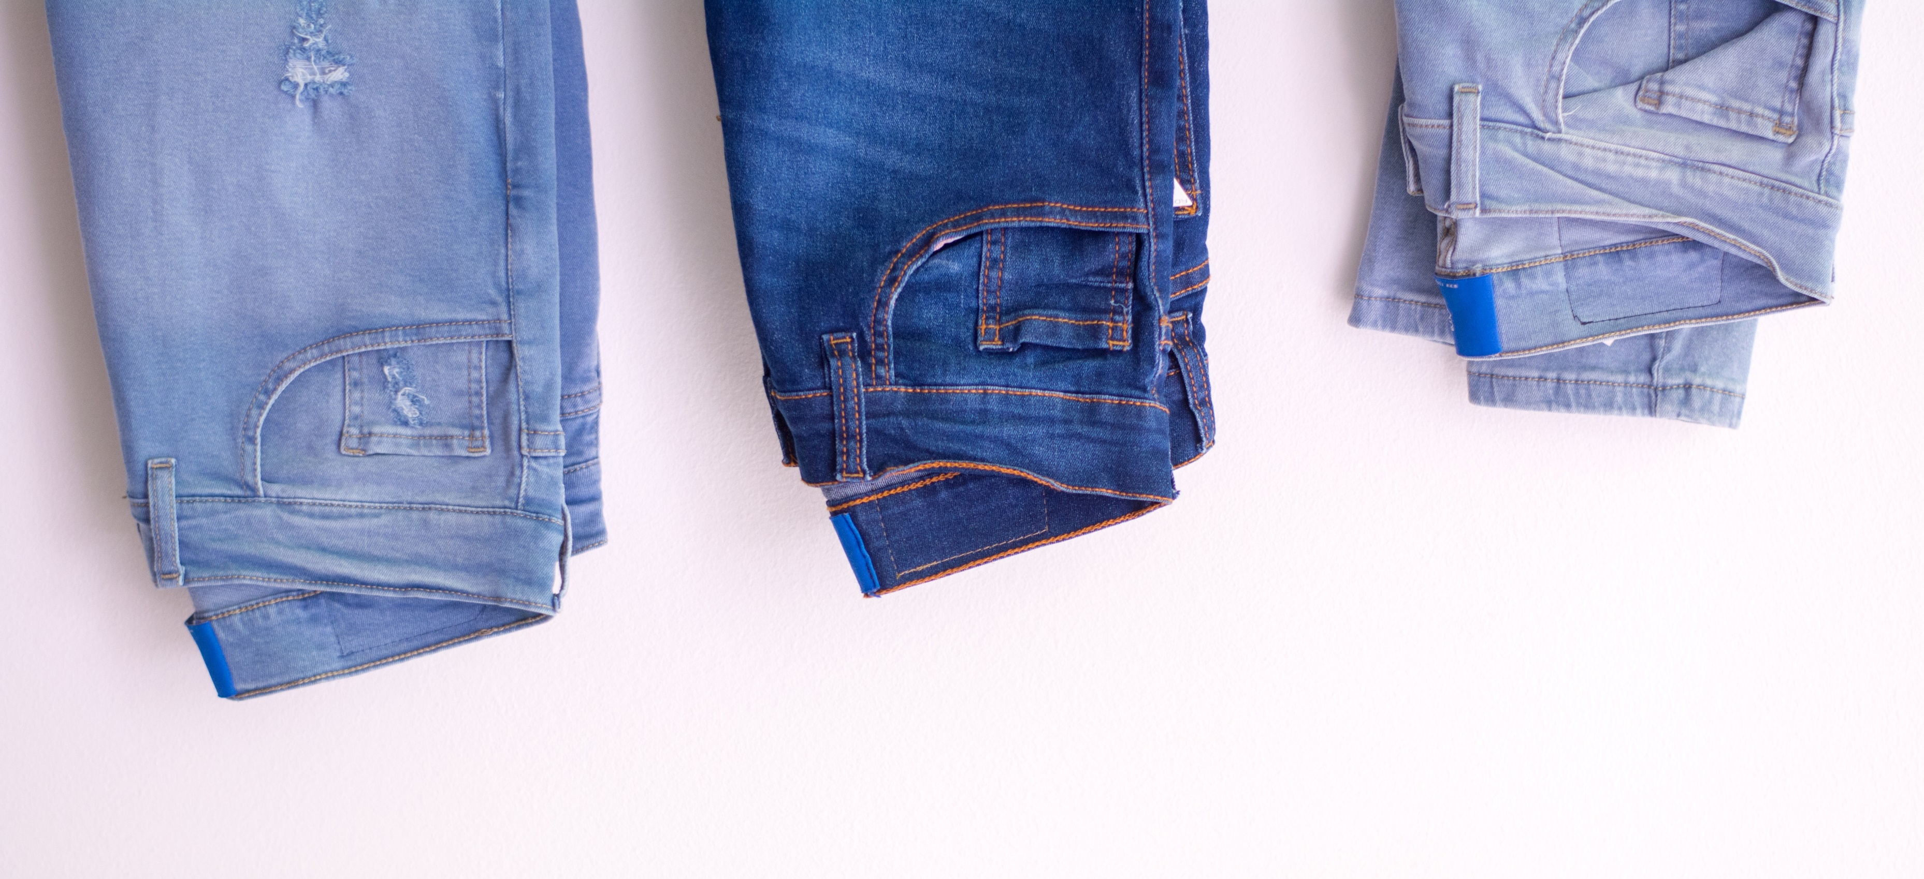
With almost two billion pairs produced each year, jeans are key for the fashion industry’s transition to sustainability
$ 42 billion
Global jeans retail market 2017¹⁾
6 pairs
Average number of pairs of jeans owned per person, globally²⁾
€ 4.9 billion
Import value of jeans in EU in 2017⁷⁾
Clothes are basic items for people and come in many different sizes, colours and finishes from a multitude of production lines. Jeans have become a popular item around the globe with almost two billion pairs of jeans sold per year on a global level, resulting in a global retail market of $ 42 billion in 2017¹⁾. On average, consumers own 6 pairs of jeans, globally²⁾. This market is only expected to increase the next couple of years³⁾. Their production comes with both positive effects, such as economic development, and negative effects on society.
The main material used in jeans is cotton, which is primarily cultivated in Asian countries such as China and India⁴⁾. The cotton is used to make denim textile, which in turn is the main input for the production of jeans. Jeans manufacturing mostly takes place in lower-wage countries such as China, Mexico, Turkey and Bangladesh, the latter having a 27% share of jeans imported by the EU⁵⁾. Along the supply chain, jeans production provides working opportunities and economic development.
However, the garment industry is also associated with negative impacts on people and planet. These are costs to society that are made during the production, but not paid for by the consumers or the companies in the value chain. For example, the intense process of cotton cultivation requires a lot of water, while it often takes place in regions with water scarcity⁶⁾. In addition, textile production and jeans manufacturing often occurs in Asian countries with high risks of labour rights violations.
Insight into external costs involved in jeans production chains, can support in minimising harm to society and achieving these goals. This report provides insights into these external costs by describing the true price of a pair of jeans from Bangladesh with denim produced in India.
1) P&S Intelligence); 2) Cotton Incorporated (2019); 3) Newbery & Wang (2017); 4) National Cotton Council of America (2019); 5) Ovi (2018); 6) Grooscurt et al. (2016); (7) European Commission (2019).

Slide 7
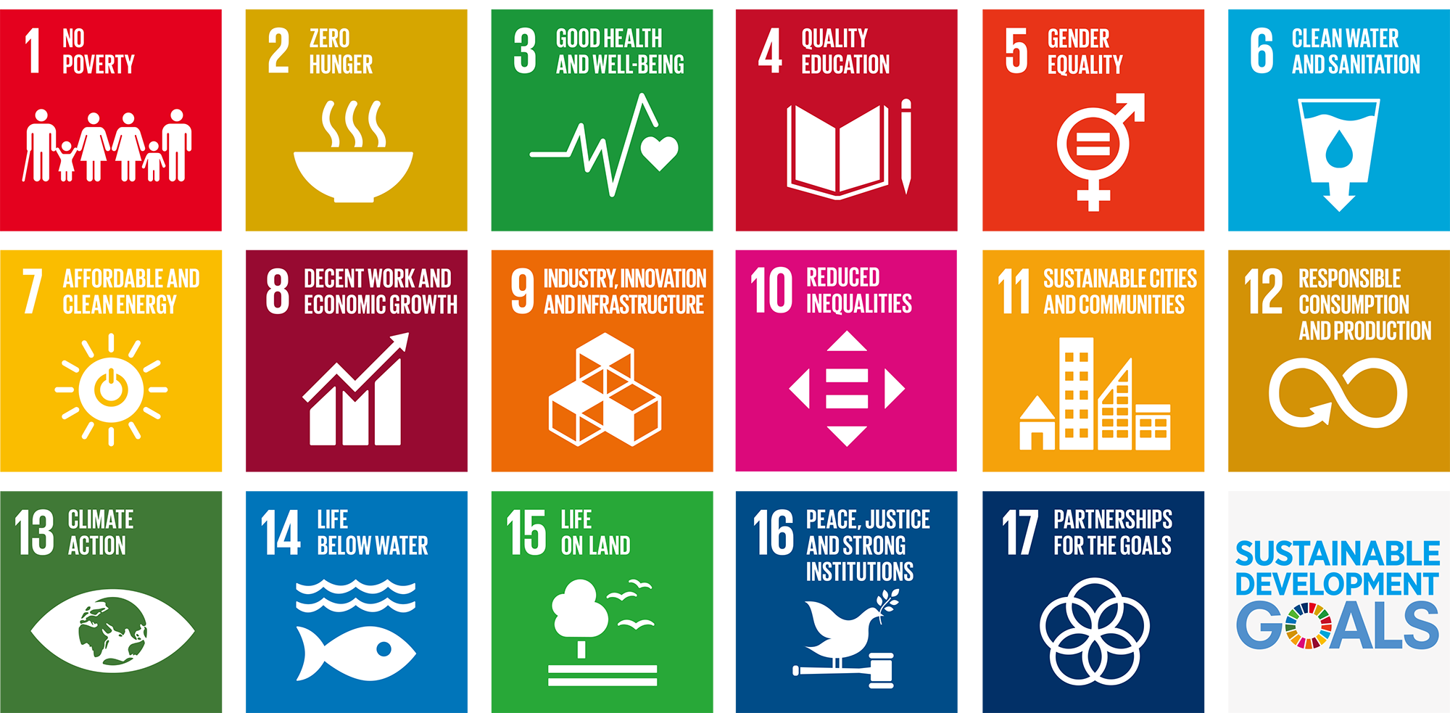
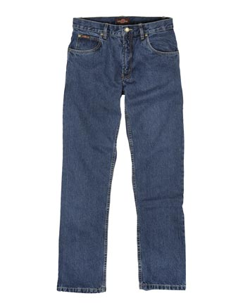
How can the fashion industry’s transition contribute to the UN Sustainable Development Goals?
External costs
Social costs
Env. costs
2018
2030
All United Nations member states have adopted the Sustainable Development Goals as part of the 2030 Agenda for Sustainable Development. The transition of the jeans industry can contribute significantly in reaching these goals. Most notably, the SDGs with a direct link to jeans production include (1) No poverty, (8) Decent work and economic growth, and (12) Responsible consumption and production.
For example, for SDG (1) No poverty, true pricing can identify key areas of improvement such as living wages¹⁾ across the jeans value chain. For SDG (8) Decent work and economic growth, working conditions such as health and safety, harassment and bonded labour are identified in the cultivation and processing steps in the value chain. For SDG (12) Responsible consumption and production, material, energy and water intensity in production are key areas for improvement.
How true pricing can contribute to the SDGs
True pricing is a unique method to quantify and present external costs. Information on true prices (first part of the report) can be used to:
Identify the biggest external costs of jeans production and improvement levers to reduce these external costs;
Draft a roadmap on how to contribute to reaching the SDGs by 2030; and
Improve the transition to a more sustainable fashion industry.
The second part of this report discusses actions that the fashion industry and consumers can take towards more sustainable jeans.
1) A living wage is the wage a worker should earn to be able to afford a decent standard of living. See the Global Living Wage Coalition for a comprehensive discussion (link).

Slide 8
Jeans production involves several steps largely located in Southern Asia
This report describes the external costs in the production process of one pair of indigo blue jeans, made of virgin cotton.
The value chain of one pair of jeans involves numerous steps and countries. First, the raw cotton is cultivated. Then, the denim textile is produced through a number of cotton processing and textile fabrication steps. In this study, these stages occur in India, one of the largest producers of both cotton and denim textile. The last step in the value chain is the production of jeans from denim textile. Here, this step takes place in Bangladesh, as it is the largest exporter of jeans to the EU.
Cotton cultivation
Production denim textile
Transport
Jeans manu-facturing
Transport
China (23%)
India (23%)
USA (16%)
Brazil (10%)
Pakistan (7%)
Share of global cotton bale production
Source: United States Department of Agriculture
China (24%)
Pakistan (18%)
Turkey (12%)
India (9%)
Japan (4%)
Share of global export value denim textile
Source: UN Statistical Division
Sea freight
Rail freight
Road freight
Air freight
Bangladesh (27%)
Turkey (23%)
Pakistan (16%)
China (10%)
Tunisia (7%)
Share of import value of jeans to EU
Source: EC Trade Statistics
Sea freight
Rail freight
Air freight
Road freight
Stated in bold is the value chain assessed in this report.

Slide 9
True pricing can support the transition to sustainable apparel
True
The true price is the retail purchasing price of a product plus the true price gap. The true price gap contains all direct external costs that are not part of the purchasing price but are paid by society nonetheless – for instance by local communities (air and water pollution), by future generations (climate change) or by employees (health and safety risks). Such external costs are harmful to society, but also pose risks to businesses.
The aim of true pricing is not to increase the retail purchasing price, but rather to reduce the true price of products by closing the gap. This can be done by creating transparency about the true price gap, which enables innovative ways of production. The true price method provides businesses with insight to improve their societal impact by reducing its true price gap. It also provides consumers information to chose more sustainable products.
Price
Social
Social impacts in scope
Insufficient wages & social security
Insufficient income
Health & Safety
Child labour
Bonded labour
Harassment
Discrimination
Overtime
Denied freedom of association
costs
True
Price
Environ-
Gap
mental
Retail purchasing price
costs
Environmental impacts in scope
Air pollution
Water pollution
Soil pollution
Climate change
Land use
Energy use
Materials use
Water use
Current product
Target product

Slide 10
True price of jeans in 2018
2

Slide 11
The true price gap of a pair of jeans is around € 30
The figure on the right shows the true price gap for a pair of jeans. This covers all external costs up until delivery to retailers, who sell the jeans to consumers. The true price gap is broken down into the following main value chain steps: cotton cultivation, denim textile production, jeans manufacturing, and transport steps in between. Key messages:
The true price gap is around € 30 per pair of jeans and the biggest contribution to the true price gap comes from social externalities.
The key contributor to the true price gap is the phase from raw cotton to denim textile. Widespread occurrence of bonded labour in this step in India is the main driver (bonded labour is work with a non-voluntary component and occurs in various forms with differing levels of severity). This is the largest single impact contributing to the true price gap.
The key environmental costs for a pair of jeans are scarce water use during cotton cultivation and energy use, during spinning and knitting in denim textile production. In addition, water pollution from the use of fertilisers in cultivation and chemicals in wet-processing of denim textile adds to the true price gap.
The production of jeans in Bangladesh is notorious for occurrences of human rights violations in factories. The main social issues in jeans manufacturing in Bangladesh concern harassment, underpayment and denied freedom of association. Per worker the external costs are high. Due to high labour productivity, the social costs are relatively low per pair of jeans, compared to the other phases in the supply chain.
True price gap for cotton production and processing to a pair of jeans. The figure shows the true price gap for each key step independently, adding up to the total true price gap of a pair of jeans. All values are in EUR per pair of jeans.

Slide 12
Cultivation mainly drives environmental costs due to large scarce blue water use
Cotton cultivation
Denim textile production
Transport
Jeans manufacturing
Transport
Around 23% of all cotton cultivated worldwide comes from India¹⁾ making it the world’s second largest producer of cotton lint. The cultivation in India has a true price gap of € 8.40. Approximately 58% of the true price gap is due to environmental externalities. The most significant impacts are scarce water use, water pollution, bonded labour and underpayment of workers.
A large amount of scarce blue water is used for irrigation during the cultivation of cotton. This exceeds 2,000 litres of scarce blue water per pair of jeans (of the total 8,000 litres of water used for virgin cotton cultivation in one pair of jeans)²⁾ and translates to a true price contribution of € 2.80. The high water intensity of cotton, combined with water scarcity in many regions in India, makes water use the highest environmental cost.
In addition, water pollution is a main driver of environmental costs. The use of nitrogen and phosphorus synthetic fertiliser causes freshwater and marine eutrophication. On average, farmers in India apply 100 kg/ha N-synthetic fertiliser, 60 kg/ha of P-synthetic fertiliser and 20 kg/ha of K-synthetic fertiliser (synthetically produced fertiliser per main nutrient)³⁾. Combined with pesticide use, this leads to € 0.95 in true price contribution⁴⁾.
The main social externalities are bonded labour (€ 1.10) and underpayment of self-employed farmers and hired workers (€ 1.50 per pair of jeans). Bonded labour is driven by men working as permanent farm servants, who are paid their annual salary upfront and forced to work the rest of the year.
Underpayment concerns earning less than a living income or wage, the payment or earnings to live a decent life⁵⁾. E.g., hired workers in cotton cultivation make on average € 560/year less than a living wage.
True price gap for cotton cultivation (EUR/pair of jeans).
1) National Cotton Council of America (2019); 2) Chapagain (2006); 3) IDH and True Price (2016); 4) Note that fertiliser and pesticide use also leads to soil pollution and climate change, but these are smaller effects than water pollution; 5) The living wage can be significantly above the legal minimum wage. See the Global Living Wage Coalition for a comprehensive discussion (link).

Slide 13
Bonded labour in denim textile production is the main driver of the true price gap
Cotton cultivation
Denim textile production
Transport
Jeans manufacturing
Transport
Denim textile production consists of several phases to convert raw cotton into denim textile; including ginning, spinning, knitting and/or weaving, wet-processing and finishing of cotton products. In this analysis, these steps are performed in India. These steps are the main driver of the true price gap of a pair of jeans at € 21.15.
About half of this true price gap is driven by the occurrence of bonded labour. Key environmental costs in this part of the value chain are energy use and air pollution.
The state of Tamil Nadu in Southern India is the largest producer of cotton yarn in India and a global sourcing hub for ready-made garments. It employs approximately 200- to 400 thousand workers in its spinning mills¹⁾.
A main driver of bonded labour in this sector is the so-called Sumangali scheme²⁾. In this scheme, young (female) workers are hired for a contract up to five years, during which they earn a wage that is paid as a lump sum at the end of the contract. The scheme is essentially bonded labour and violates ILO standards³⁾. In addition, characteristics of camp labour occur, where workers are physically restricted⁴⁾. Conservative estimates state that roughly one-third of workers are in some kind of bonded labour⁵⁾, but higher numbers are also reported⁶⁾. Combined, we estimate that bonded labour contributes € 10.85 to the true price gap of a pair of jeans.
Environmental costs are mainly due to high energy use in spinning and weaving mills and air pollution. In the dyeing and spinning phase, sulphur dioxide is emitted through air, resulting in acidification of the environment.
True price gap for denim textile production (EUR/pair of jeans).
1) & 4) & 6) India Committee of the Netherlands (2016); 2) See i.e. Solidaridad (2012) for an in-depth analysis of the Sumangali scheme; 3) Since 1919, the International Labour Organization (ILO) has maintained and developed a system of international labour standards aimed at promoting opportunities for women and men to obtain decent and productive work, in conditions of freedom, equity, security and dignity. 5) Bhalla (2015)

Slide 14
Jeans manufacturing is mainly associated with social issues
Cotton cultivation
Denim textile production
Transport
Jeans manufacturing
Transport
Jeans manufacturing consists of cutting, stitching, sewing, washing, finishing denim textile into a pair of jeans. As main exporting country to the EU, these steps are analysed for Bangladesh. Ready-made garment – including jeans – covers over 80%¹⁾ of the exports of Bangladesh, making it a main driver of the country’s economy.
Factories in Bangladesh have a high productivity: the average factory worker produces over 5,000 pairs of jeans a year²⁾. In other words: cutting, sewing and stitching a pair of jeans only takes on average 25 minutes. While several human rights violations occur in this step of the value chain, the true price gap per pair of jeans is € 3.30 due to this high productivity.
Environmental externalities contribute 15% to the true price gap of this step, caused by electricity and water use. Two main social issues here are harassment of workers (€ 1.70 true price gap) and denied freedom of
association (€ 0.60 true price gap).
Exploitation of women workers in clothing factories is one of the key social externalities. In Bangladesh, women workers, accounting for 85% of the total workforce in the garment industry³⁾, face many forms of mistreatment. 23% of workers experience verbal harassment (compared to 9%-18% in denim textile production) and one in four women is victim of physical sexual harassment⁴⁾.
Another important externality is denied freedom of association: 97.5% of garment factories in Bangladesh are estimated to have no trade unions⁵⁾.
The living wage gap for hired workers in garment factories in Bangladesh is the largest in the chain at € 1.060 per FTE per year⁶⁾ (compared to living wage gaps in denim textile production in India ranging from € 330 to € 840)⁷⁾. However, as productivity is high, in this step the impact per pair of jeans is relatively small (€ 0.30 true price gap).
True price gap for jeans manufacturing (EUR/pair of jeans).
1) BGMEA (2019); 2) Dhaka Tribune (2018) and Montazer & Maryan (2009); 3) & 4) Alam et al. (2011); 5) Centre for Policy Dialogue (CPD) Bangladesh in The Independent (2018); 6) Global Living Wage Coalition (2018) and Haque & Bari (2015); 7) IDH and True Price (2016)

Slide 15
Transport accounts for relatively small environmental costs
Cotton cultivation
Denim textile production
Transport
Jeans manufacturing
Transport
In the value chain, two transport steps are included. First, the transportation of the denim textile from India to Bangladesh, by sea freight. Second, transportation over sea of the ready-made garment from Bangladesh to the Netherlands.
In the transportation step, we focus on environmental externalities, such as climate change, energy use, and air and water pollution. Social externalities in shipping exist, but are assumed only a small proportion of the workers involved in the jeans value chain, and as such deemed negligible.
The true price gap for the transportation to Bangladesh amounts to less than € 0.01. The true price gap for the transportation to the Netherlands is less than € 0.04. Both are mainly driven by water pollution.
Even though there are notable environmental externalities from sea freight, these costs are relatively small per pair of jeans due to large volumes of jeans per shipment.
True price gap for the transportation of denim textile from India to Bangladesh (left figure) and transportation from Bangladesh to the Netherlands (right figure) (EUR/pair of jeans).

Slide 16
True price of jeans towards 2030
3

Slide 17
Improving the sustainability of the jeans value chain
Visual representation of a roadmap towards a more sustainable jeans sector. The current level of social and environmental costs be reduced though a number canof targeted interventions by the fashion industry, closing the true price gap (ceteris paribus for each intervention). The interventions are explained in more detail on the next page.
The first part of this report focused mainly on the external costs of the phases of jeans production. Of course, the global jeans sector also has a strong positive effect on developing economies.
Cotton in India is grown by around 5.8 million farmers and 50 million people indirectly depend on the cotton sector for their livelihood¹⁾. In addition, the manufacturing of jeans – and other textiles – in Bangladesh is a major driver of the country’s economy. The ready-made garment (RMG) industry employs around 20 million people and covers over 80% of Bangladesh’s total exports²⁾.
Roadmap to a sustainable jeans sector
However, to become a sustainable sector, the jeans industry should focus on decreasing the harm to society. An effort to draft a complete assessment of externalities can be input for a roadmap towards an increasingly sustainable sector. Using the insights offered by the true price analysis of the jeans value chain, this section identifies and discusses next steps. The main areas for improvement are typically the steps in the value chain with the largest externalities, in this case cotton cultivation and denim textile production.
Cotton cultivation
The cultivation of cotton contributes 25% to the total true price gap of a pair of jeans, mainly driven by water use and low wages/earnings. In India, where cotton is produced mainly by smallholder farmers with relatively low yields per ha, it is difficult to earn a living income.
Investing in better technologies, increasing transparency measures, providing training to farmers and improving working conditions of hired labour could contribute significantly to decreasing the true price gap of jeans.
Denim textile production
Workers in denim textile production suffer from poor working conditions, low wages and the occurrence of bonded labour.
Improving this sector is not easy. Addressing the predominantly social issues requires understanding the societal and cultural context in which these take place³⁾. Moreover, there is fierce international competition, so an exclusion strategy may only lead to a shift in location of externalities.
Working together with (local) governments, organizations and communities can combine more sustainable production with economic development.
1) India Today (2018); 2) BGMEA (2019); 3) Delaney & Connor (2016)

Slide 18
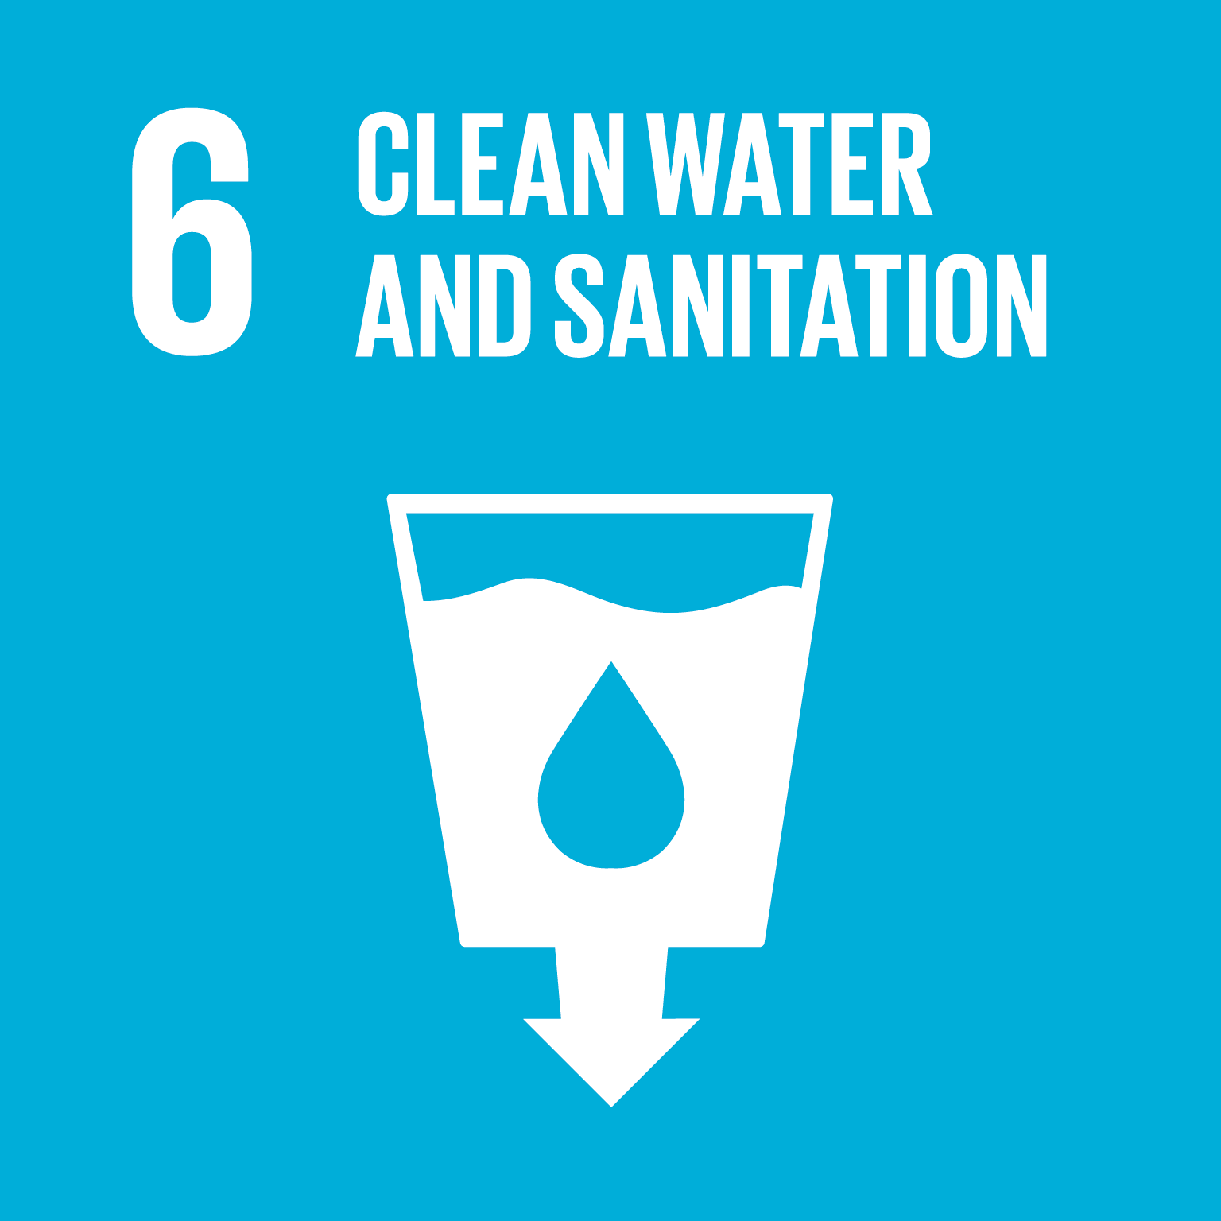
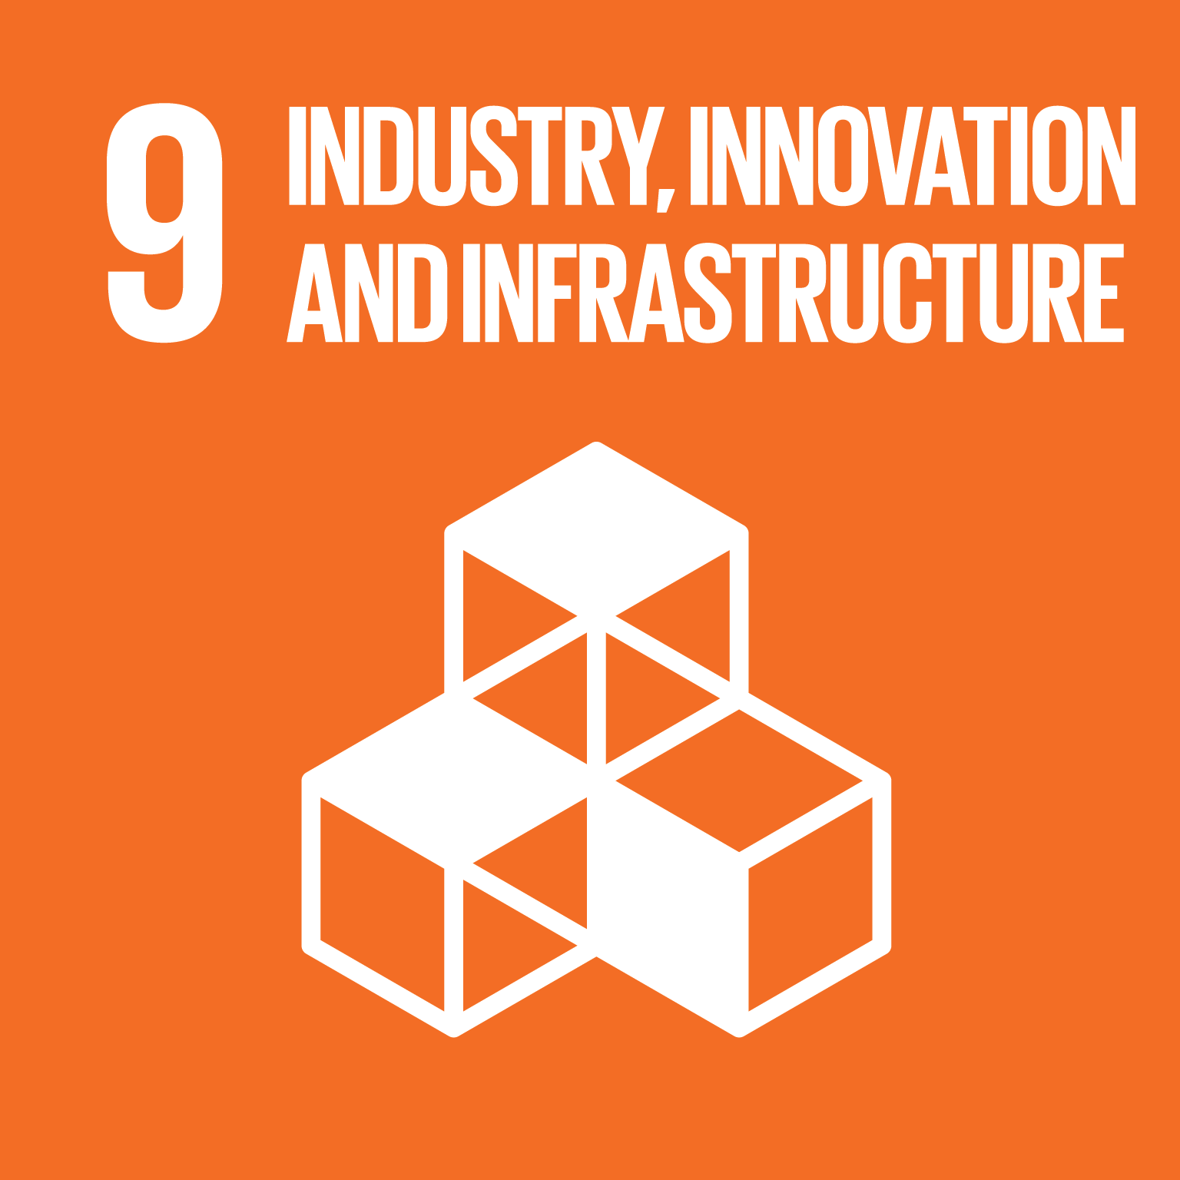
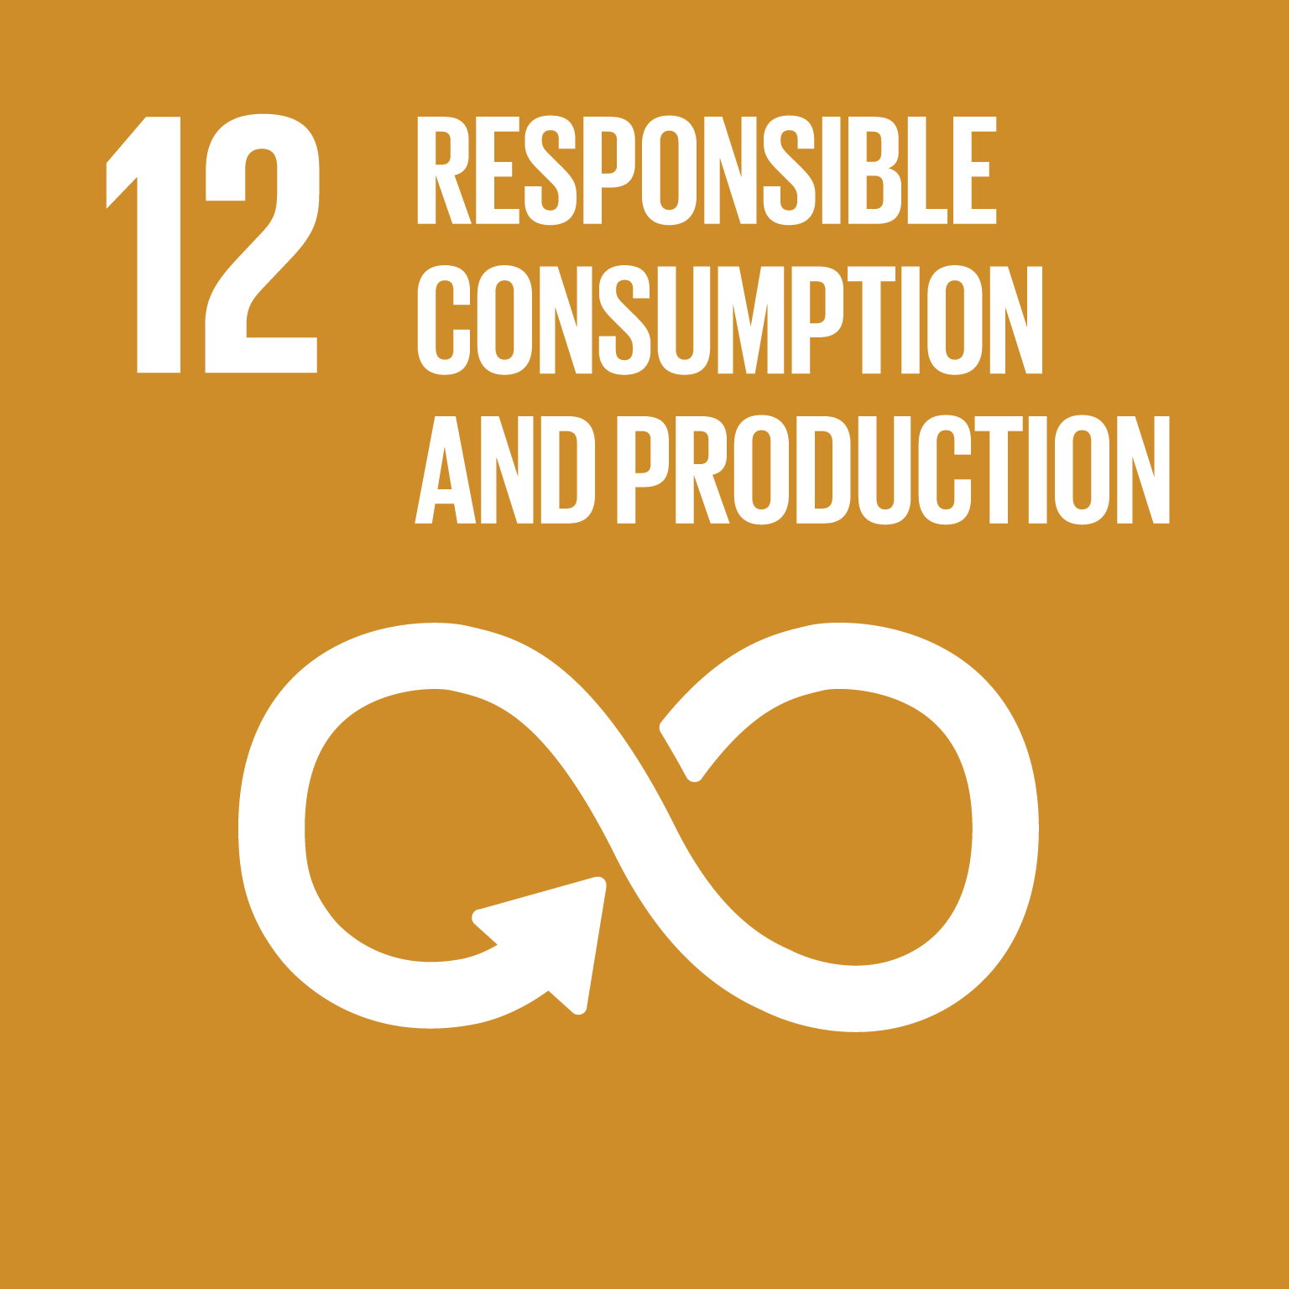
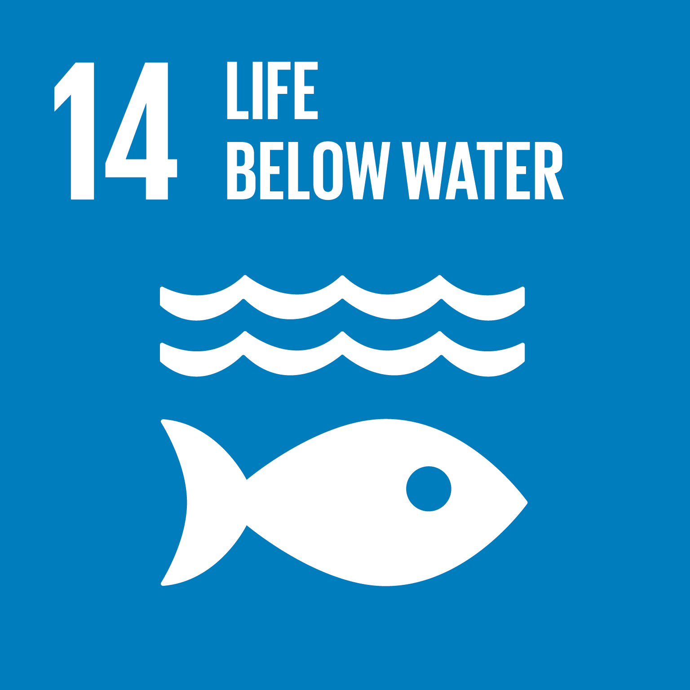
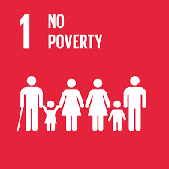

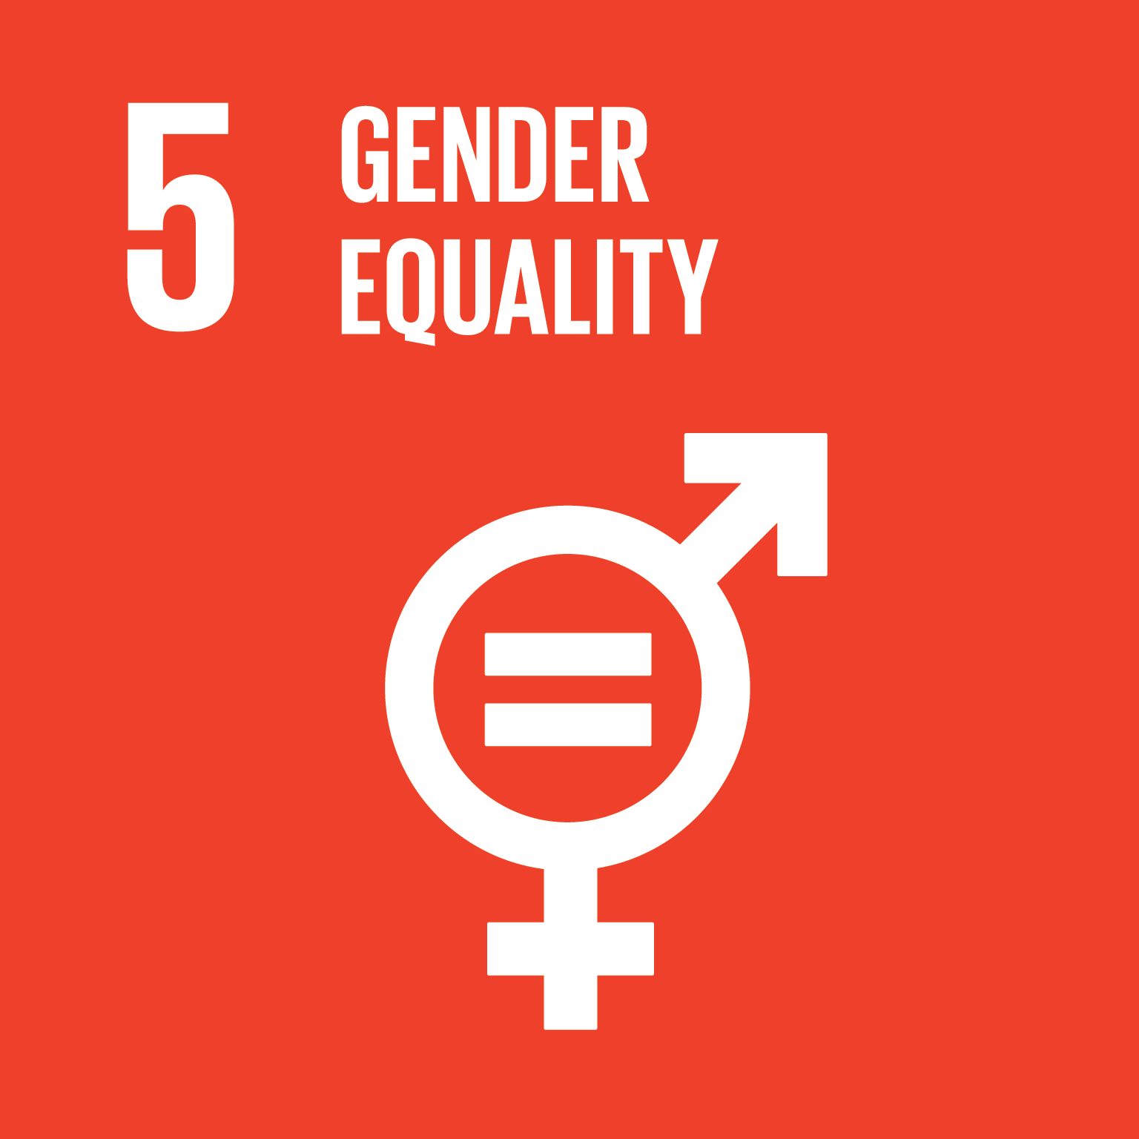
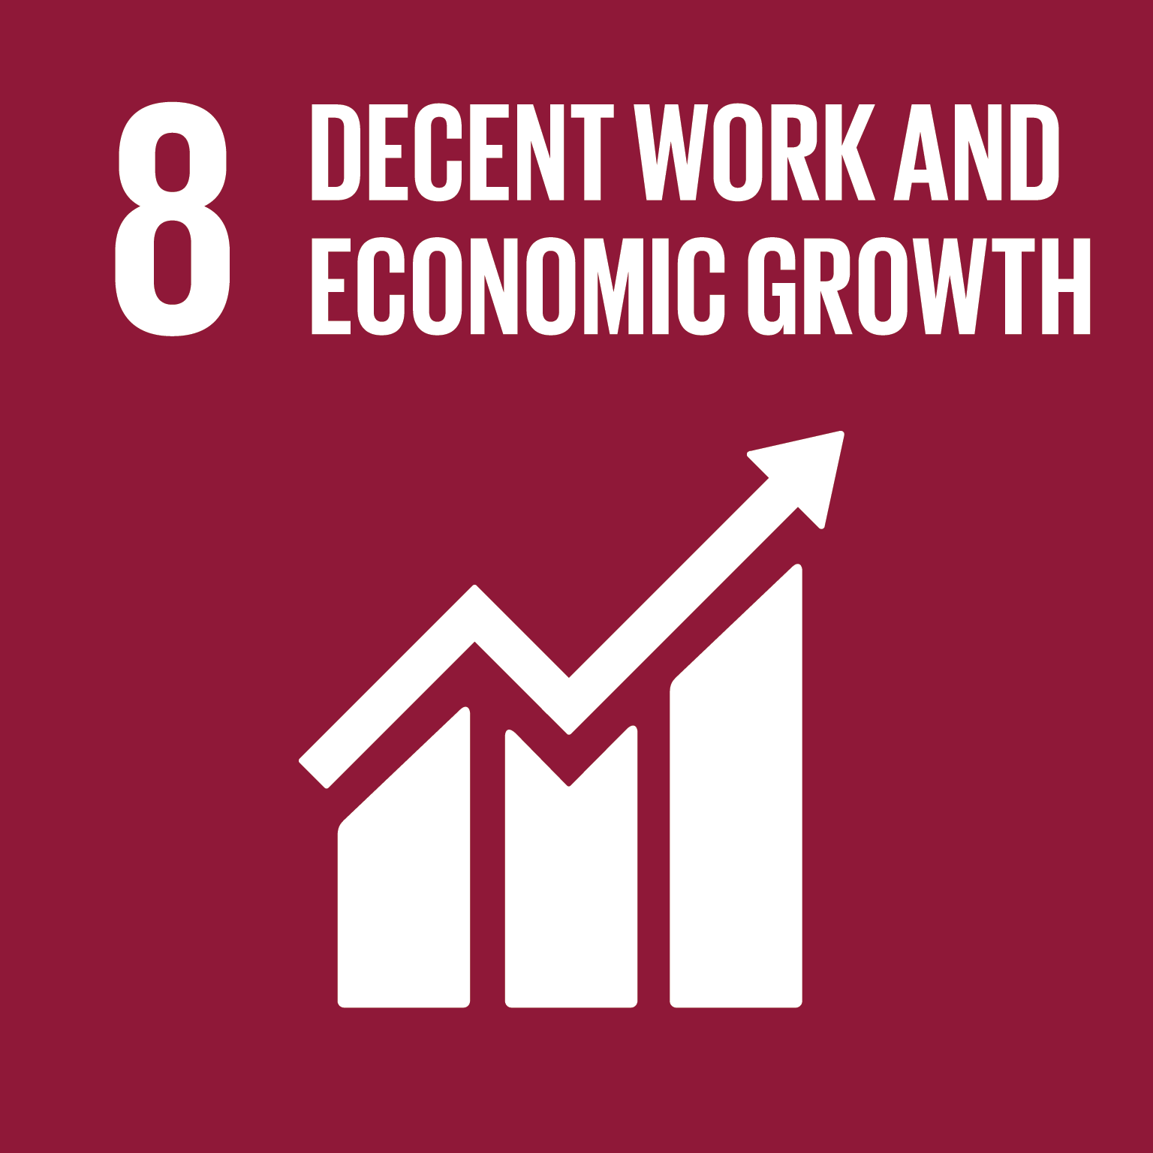

Industry interventions can save billions in external costs
Improved cotton production
Social engagement in value chain
Circularity
Water use efficiency in India: all cotton produced using more efficient irrigation:
Reduction in true price gap: € 0.70
Potential: € 330 million for all jeans produced in Bangladesh
Address bonded labour in textile production in India (95% reduction):
Reduction in true price gap: € 10.30
Potential: € 5 billion
Paying full living income and wages in India and Bangladesh
Reduction in true price gap: € 2.95
Potential: € 1.4 billion
Re-using denim textile from jeans
Reduction in true price gap: € 1.35
Potential: € 600 million
SDG contribution
SDG contribution
SDG contribution
Next to addressing the main issues along the value chain, we offer concrete interventions for the jeans sector in three key areas:
Improved cotton production
Social engagement in value chain
Circularity
All interventions are based on the value chain in scope, which is representative for all jeans produced in Bangladesh, with denim textile from India as specified in this value chain.
Improved cotton production
The main externality in cotton cultivation is the extreme use of scarce water. This has for example been linked to the drying up of the Aral Sea in Uzbekistan¹⁾ and has high costs in water-challenged countries such as India²⁾. Using rainwater and drip irrigation in India can increase water use efficiency³⁾ compared to traditional irrigation techniques and can save an estimated € 330 million in external costs (€ 0.70 per jeans).
Social engagement in value chain
The key contributor to the true price gap is bonded labour in denim textile production in India. Increasing community capacity to prevent bonded labour and taking action for labourers that are currently victims of bonded labour is already done, for example by the Freedom Fund⁴⁾. When bonded labour is addressed and reduced by 95%, the true price gap can decline with ~€ 5 billion (€ 10.30 per jeans).
Moving towards paying living income (e.g. for self-employed farmers) and living wages (for hired workers) throughout the value chain of jeans can alleviate many workers out of poverty. Organisations such as Asia Floor Wage Alliance and the Fair Wear Foundation are already striving towards this, the latter working with brands and industry influencers to improve working conditions. Paying all workers throughout the supply chain a living income or living wage avoids ~€ 1.4 billion in external costs (€ 2.95 per jeans).
Circularity
Re-using the valuable denim from jeans through recycling can avoid a large share of the total true price gap of a pair of jeans produced from virgin materials. Companies such as MUD Jeans, Levi’s and Kuyichi are already pioneering in this field. Scaling this up by re-using 15% of the post-consumer textile⁵⁾ and quantifying the impact can save € 600 million in the true price gap, decreasing environmental and social costs.
1) Hoskins (2014); 2) Shiao et al. (2015); 3) Safaya et al. (2016); 4) The Freedom Fund (2019); 5) Smits (2018)

Slide 19
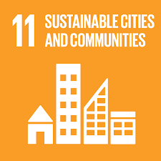
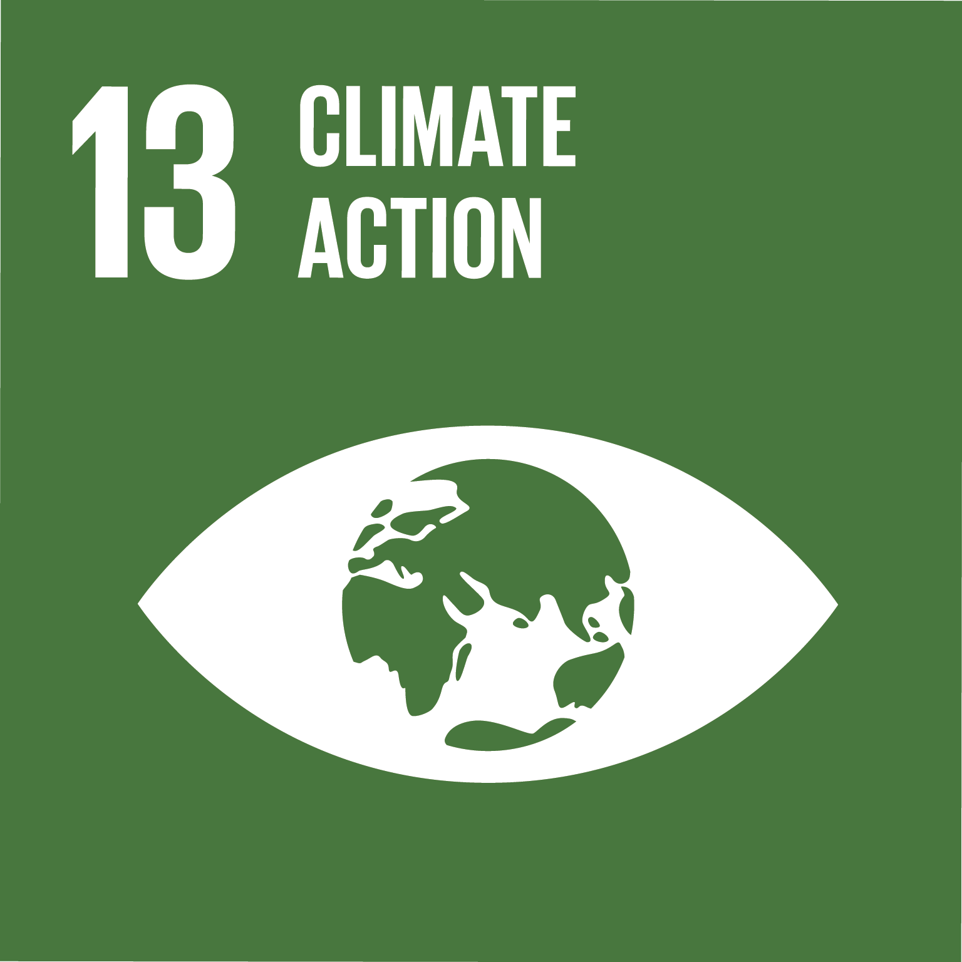
Consumers can also reduce billions in external costs
Buy responsibly
Wearing jeans twice as long, avoiding consumption of jeans
Reduction in true price gap: € 16.45
Potentially € 8 billion for all jeans produced in Bangladesh
The true price of jeans covers all the external costs of jeans production, up to the point where the jeans are ready for sell to consumers. Consumer use is not part of this, but it does contribute to the total external costs over the full life cycle of a pair of jeans, for example through frequent washing of jeans. Therefore, conscious and responsible behaviour of consumers can also contribute to lowering external costs.
Buy responsibly
Every year, around € 500 million pairs of jeans are produced in Bangladesh¹⁾. Consumers on average already own six pairs of jeans. Prolonging the use of a pair of jeans and delaying buying new jeans can avoid the full true price gap. If all yearly produced jeans
in Bangladesh would be worn twice as long, external costs could decline by ~€ 8 billion. More durable and slower (compared to fast-) fashion might also contribute to this.
Be lazy, wash less
During the consumer use phase of a pair of jeans, the main external costs are from washing the jeans. On average, one washing uses around 55 litres of water²⁾ and 0.5 kWh of electricity³⁾. Currently, people wash their jeans very regularly, often out of habit and without the jeans being dirty. Extending the period between washing a pair of jeans can save up to € 430 million annually in external costs for all jeans yearly produced in Bangladesh. Moreover, washing less often reduces the wear of the jeans, leading to an extended period of use.
SDG contribution
Be lazy, wash less
Extending the time between washing jeans*
Reduction in external costs: € 0.90
Potentially € 430 million for all jeans produced in Bangladesh
SDG contribution
1) Dhaka Tribune (2018); 2) Vitens (2010); 3) Milieu Centraal (2019);
* This intervention reduces societal impact. However, it does not reduce the true price gap, as it takes place after purchasing jeans

Slide 20
Appendix
4

Slide 21
This report assesses a value chain from cotton cultivation to delivery for retail
In this study we have used the following functional unit:
One pair of indigo jeans, entirely made of virgin cotton
Average size and non-ripped model for adults (weighing 600g)
Activity
Cotton cultivation
Production yarn
Production fabric
Transport
Production jeans
Transport
Retail
Consumer use**
End of life
India
India – Bangladesh
Bangladesh
Bangladesh – NL
The Netherlands
Materials in scope
(95% of weight of jeans)
Cotton bales
Cotton yarn, dye
Denim textile
Jeans
Materials out of scope
(5% of weight of jeans)
Polyester yarn
Polyester yarn, metal, (fake) leather
In true price scope
Out of true price scope

Slide 22
Detailed overview of value chain steps
Cotton cultivation, yarn production and textile production
The production steps of cotton cultivation, yarn production and textile production in India have been analyzed in a study on the True Price of Cotton in a collaboration between True Price and IDH¹⁾. Results from this study were used for this report. In order to align with the most recent methodological developments of true pricing, several monetization factors were updated. The output of this step is blue-dyed denim, made of 100% virgin cotton, ready for jeans production.
Transport In this step the denim textile is transported from India to Bangladesh.
Jeans production
The input of this step is the denim textile as produced in the previous step. In this step the textile is cut, sewn, finished and washed (for adding washed-down look to the jeans), all in Bangladesh. In this step, other components, such as labels, pockets, buttons, rivets and zippers, are added to the jeans. The external costs of these components are out of scope for this analysis. Output of this step is a finished pair of jeans, ready to be shipped to the Netherlands.
The calculation of the external costs of this step was performed on material external costs and based on secondary data.
Transport
The last step for the true price calculation of the jeans is the transport step from Bangladesh to the Netherlands. In this step, mainly environmental external costs are material. The output of this step is a pair of jeans, ready for retail and purchase by the consumer.
Retail
After delivery to the Netherlands, the jeans are distributed and sold by retail companies. This step is out of scope for this analysis.
Consumer use
The use of the jeans by the consumer is an important aspect of the total lifecycle of the jeans. Due to regular washing (and drying) of the jeans, the consumer uses, among other inputs, water and electricity. It is assumed that these washing cycles take place in the Netherlands. This step is by definition not considered in the true price, as it happens after the purchase of the product. However, (environmental) impacts are considered in the possible interventions for consumers to decrease the total impact of the jeans.
End of life
In the end of life phase of the jeans the consumer can dispose it, and the jeans can end up in landfill, be incinerated or used for recycling. This step is out of scope for this analysis.
1) IDH and True Price (2016)

Slide 23
External costs in scope for this report
Impact | Description
Environmental externalities
Air pollution | Emission of toxic gasses (e.g., NOx and SOx), mainly related to energy use.
Water pollution | Pollution of water with acidifying and other toxic pollutants.
Soil pollution | The pollution of soil in the value chain, e.g. due to the use of fertilisers.
Climate change | Emission of carbon dioxide and other greenhouse gasses mainly through electricity and other energy use.
Land use | Land use in the value chain, e.g. for growing of crops.
Energy use | Use of energy in the value chain, e.g. for manufacturing processes.
Materials use | Mineral and fossil fuel resource depletion in the value chains; fossil fuel resource depletion due to operations.
Water use | The use of blue water, reducing the availability of water for human use. Water use is only a relevant impact in regions where water is scarce.
Social externalities
Insufficient income | Entrepreneurs having less income than the so-called living income (that is sufficient for a decent standard of living).
Insufficient wages & social security | Workers earning below the so-called living wage (that is sufficient for a decent standard of living). Note that the living wage can be above the legal minimum wage. Absence of social security (e.g., unemployment savings and sick leave) also contributes to the true price gap.
Health & safety | Mainly determined from fatal and non-fatal incidents at work. Working in an unsafe working environment adds to the true price gap.
Child labour | Occurrence of child labour according to the ILO criteria.
Bonded labour | Occurrence of bonded labour. Bonded labour is work with a non-voluntary component and occurs in various forms with differing levels of severity.
Harassment | (Sexual and non-sexual) harassment of workers, including health effects and treatment costs.
Discrimination | Reflects to the absence of paid maternity leave, and the gender wage gap, where women earn less than men for similar work.
Overtime | Workers experiencing excessive working hours (more than the maximum legal working hours).
Denied freedom of association | Denied freedom for workers to form and/or join trade or labour unions.

Slide 24
List of sources
5

Slide 25
Sources
Alam, K., Blanch, L., & Smith, A. (2011). Stitched up: women workers in the Bangladeshi garment sector. War on Want. Available at: https://waronwant.org/sites/default/files/Stitched%20Up.pdf
Anner, M., & Bair, J. (2016). The bulk of the iceberg: a critique of the Stern Center’s Report on worker safety in Bangladesh. Center for Global Workers’ Rights. https://ler.la.psu.edu/gwr/documents/CGWRCritiqueofSternReport.pdf
Åslund, E. H. (2018). Comparative life cycle assessment of jeans: A case study performed at Nudie Jeans. KTH Royal Institute of Technology. Available at: https://kth.diva-portal.org/smash/get/diva2:1221104/FULLTEXT01.pdf
Bangladesh Employer Federation. (2009). A handbook on The Bangladesh Labour Act, 2006. Available at: https://www.ilo.org/dyn/travail/docs/352/A%20Handbook%20on%20the%20Bangladesh%20Labour%20Act%202006.pdf
Bangladesh Institute of Labour Studies-BILS. (2015). National minimum wage for Bangladesh’s workers: Rational standard and rationality of national minimum. Available at: http://bilsbd.org/wp-content/uploads/2016/03/NMW_MJF.pdf
Bangladesh Parliament. (2013). Bangladesh gazette. Additional issues. Act No. 30 of 2013. Available at: https://www.ilo.org/wcmsp5/groups/public/---ed_protect/---protrav/---ilo_aids/documents/legaldocument/wcms_229274.pdf
Better Work Foundation (2019).Better Work Bangladesh. Available at: https://betterwork.org/where-we-work/bangladesh/
BGMEA. (2019). Comparative statement on export of RMG and total export of Bangladesh. Available at: http://www.bgmea.com.bd/home/pages/tradeinformation
Bhalla, N. (2015). Captured by cotton: Girls duped into "bonded labour" in India's textile mills. Reuters. Available at: https://www.reuters.com/article/india-textiles-women/feature-captured-by-cotton-girls-duped-into-bonded-labour-in-indias-textile-mills-idUSL5N10F3IF20150806
Biswas, A. (2017, December 24). Coastal shipping boosts Bangladesh-India bilateral trade. Dhaka Tribune. Available at: https://www.dhakatribune.com/business/commerce/2017/12/23/coastal-shipping-boosts-bangladesh-india-bilateral-trade
Chapagain, A. K., Hoekstra, A. Y., Savenije, H. H., & Gautam, R. (2006). The water footprint of cotton consumption: An assessment of the impact of worldwide consumption of cotton products on the water resources in the cotton producing countries. Ecological economics, 60(1), 186-203. Available at: http://aoatools.aua.gr/pilotec/files/bibliography/water_cotton-3000168704/water_cotton.pdf
Children Act, 2013. Law No. 24, 2013. Available at: http://bdlaws.minlaw.gov.bd/bangla_all_sections.php?id=1119
Cotton Incorporated (2019). How many pairs of jeans do consumers own? Cotton Lifestyle Monitor. Available at: https://lifestylemonitor.cottoninc.com/how-many-pairs-of-jeans-do-consumers-own/
de Haan, B. R. (2017). Exploring life cycle sustainability in the fashion industry: A case study on the impacts in the life cycle of garments and the application of Life Cycle Assessment in a company. Radboud University. Available at: https://theses.ubn.ru.nl/bitstream/handle/123456789/5420/Haan_de%2C_Berber_1.pdf?sequence=1

Slide 26
Sources
Delaney, A., & Connor, T. (2016). Forced Labour in the Textile and Garment Sector in Tamil Nadu, South India: Strategies for Redress. Corporate Accountability Research. Available at: http://corporateaccountability.squarespace.com/s/NJM13_sumangali.pdf
European Commission. (2019). Trade – Market access database. Product code: 62034231. Available at: http://madb.europa.eu/madb/statistical_form.htm
Fair Wear Foundation. (n.d.). Bangladesh. Available at: https://www.fairwear.org/country/bangladesh/
Fair Wair Foundation (2016). Bangladesh country study 2015. Available at: https://www.fairwear.org/wp-content/uploads/2016/06/BangladeshCountryStudy2016.pdf
Gallagher, C., Stuart, G., Noggle, E. Bangladesh. (n.d.). Working on two fronts: Gender relations and factory conditions. Garment Worker Diaries. Available at: https://www.fashionrevolution.org/wp-content/uploads/2017/04/Garment_Worker_Diaries_Bangladesh_Interim_Report.pdf
Global Living Wage Coalition (2018). Global Living Wage Series Bangladesh. Available at: https://www.globallivingwage.org/wp-content/uploads/2018/05/Dhaka_Living_Wage_Benchmark_Infographic.pdf
Haque, A. K. E., & Bari, E. (2015). Garment workers in Bangladesh: Social impact of the garment industry. Asian Center for Development.
Hoda, K. (2014). A Look into the journey of garment worker rights in Bangladesh 2013-14. Research Initiative for Social Equity (RISE) Society. Available at: https://risebd.wordpress.com/2014/02/25/worker_rights_201314_bangladesh/
Hoskins, T. (2014, October 1). Cotton production linked to images of the dried up Aral Sea basin. The Guardian. Available at: https://www.theguardian.com/sustainable-business/sustainable-fashion-blog/2014/oct/01/cotton-production-linked-to-images-of-the-dried-up-aral-sea-basin
ICF International. (2012). Child labor in the informal garment production in Bangladesh. Task Order II, Task VI: In-Country Mixed-Methods Research and Data Collection. Available at https://www.dol.gov/ilab/reports/pdf/2013garmentbangladesh.pdf
IDH and True Price: Grosscurt, C., de Groot Ruiz, A., Fobelets, V. (2016). The True Price of Cotton from India*. Available at: https://trueprice.org/wp-content/uploads/2016/04/TP-Cotton.pdf
*using this study led to some modifications for adaptation to the current study
India Committee of the Netherlands. (2016). Fabric of slavery: Large scale of forced (child) labour in South India’s spinning mills. Available at: http://www.indianet.nl/pdf/FabricOfSlavery.pdf
India Today. (2018, October 1). Textile Industry in India: Latest facts, figures and government schemes. Available at: https://www.indiatoday.in/education-today/gk-current-affairs/story/textile-industry-in-india-latest-facts-figures-government-schemes-1353406-2018-10-01
International Labour Organization. (1965). Factories Act, 1965. Available at: https://www.ilo.org/dyn/natlex/docs/WEBTEXT/47346/65073/E65BGD01.htm#a050
International Labour Organization (2009). Direct Request (CEACR) - adopted 2008, published 98th ILC session (2009). Available at: https://www.ilo.org/dyn/normlex/en/f?p=NORMLEXPUB:13101:0::NO::P13101_COMMENT_ID:3184768

Slide 27
Sources
International Labour Organization. (2016). Improving working conditions in the ready made garment industry: Progress and achievements – Bangladesh. Available at: https://www.ilo.org/dhaka/Whatwedo/Projects/WCMS_240343/lang--en/index.htm
International Labour Organization. (2019a). Better Work Bangladesh programme (BWB). Available at: https://www.ilo.org/dhaka/Whatwedo/Projects/WCMS_402978/lang--en/index.htm
International Labour Organization. (2019b). Status in employment -- ILO modelled estimates, Nov. 2018. Available at: https://www.ilo.org/ilostat/faces/oracle/webcenter/portalapp/pagehierarchy/Page3.jspx?MBI_ID=32&_afrLoop=347574686869997&_afrWindowMode=0&_afrWindowId=1a2yn0dm19_6#!%40%40%3F_afrWindowId%3D1a2yn0dm19_6%26_afrLoop%3D347574686869997%26MBI_ID%3D32%26_afrWindowMode%3D0%26_adf.ctrl-state%3D1a2yn0dm19_62
ILOSTAT. (2019). Key indicators of the labour market. Available at: https://www.ilo.org/ilostat/faces/ilostat-home?_afrLoop=790043670145965&_afrWindowMode=0&_afrWindowId=null
Islam, M. K., & Zahid, D. (2012). Socioeconomic deprivation and garment worker movement in Bangladesh: A sociological analysis. American Journal of Sociological Research, 2(4), 82-89.
Khan, M. E., Anker, R., Anker, M., & Barge, S. (2016). Living wage report Dhaka, Bangladesh and satellites cities – Context: garment industry. Global Living Wage Coalition. Available at: https://www.globallivingwage.org/wp-content/uploads/2018/05/Dhaka_Living_Wage_Benchmark_Report.pdf
Khan, N. R., Dipti, T. R., Ferdousi, S. K., Hossain, M. Z., Ferdousi, S., Sony, S. A., Zafrin, N., Paul, N., & Islam, M. S. (2015). Occupational Health Hazards Among Workers of Garment Factories in Dhaka City, Bangladesh. Journal of Dhaka Medical College, 24(1), 36-43.
Klingel. (2019). Jeans fun facts – Alle feitjes die je wilt weten over je geliefde spijkerbroek. Available at: https://www.klingel.nl/jeans-verjaardags-infographic/
Levi Strauss & Co (2015). The life cycle of a jean - understanding the environmental impact of a pair of LEVI's 501 jeans. Available at: https://levistrauss.com/wp-content/uploads/2015/03/Full-LCA-Results-Deck-FINAL.pdf
Mariani, R. D., & Valenti, F. (n.d.). Working conditions in the Bangladeshi garment sector: Social dialogue and compliance. Fair Wear Foundation & Delft University of Technology. Available at: https://www3.fairwear.org/ul/cms/fck-uploaded/documents/countrystudies/bangladesh/WorkingconditionsintheBangladeshigarmentsectorSocialdialogueandcompliance.pdf
Menzel, A., & Woodruff, C. (2017). Gender wage gaps and worker mobility: Evidence from the garment sector in Bangladesh. Department of International Development United Kingdom. Available at: https://www.gov.uk/dfid-research-outputs/gender-wage-gaps-and-worker-mobility-evidence-from-the-garment-sector-in-bangladesh
Milieu Centraal. (2019). Wasmachine. Available at: https://www.milieucentraal.nl/energie-besparen/apparaten-en-verlichting/huishoudelijke-apparaten/wasmachine/
Moazzem, K. G. (2014). Feasibility study of The Garment Industry Transparency Initiative (GITI): case of Bangladesh. The Garment Industry Transparency Initiative. Available at: https://www.governance-platform.org/wp-content/uploads/2017/01/GITI-Feasibility-Study_Bangladesh_September-2014.pdf

Slide 28
Sources
Montazer, M., & Maryan, A. S. (2009). Influences of different enzymatic treatment on denim garment. Applied biochemistry and biotechnology, 160(7), 2114-2128.
National Cotton Council of America. (2019). Crop data rankings. Available at: http://www.cotton.org/econ/cropinfo/cropdata/rankings.cfm
Newberry, M., & Wang, W. (2017). Global market review of denim and jeanswear – forecasts to 2022. Malcolm Newberry Consulting.
Oanda (2019). Currency converter. Available at: https://www.oanda.com/currency/converter/
OECD. (2003). Glossary of statistical terms. Available at: https://stats.oecd.org/glossary/detail.asp?ID=1986
Ovi, H. I. (2018, May 8). Bangladesh takes over global denim market. Dhaka Tribune. Available at: https://www.dhakatribune.com/opinion/special/2018/05/08/bangladesh-takes-global-denim-markets
P&S Intelligence (2018). Denim Market Overview. Available at: https://www.psmarketresearch.com/market-analysis/denim-jeans-market
Quattri, M., & Watkins, K. (2016). Child labour and education: A survey of slum settlements in Dhaka. Overseas Development Institute. Available at: https://www.odi.org/sites/odi.org.uk/files/resource-documents/11145.pdf
Rahman, M., Bhattacharya, D., & Al-Hasan, M. (2018). The role of the informal sector in inclusive growth a state of knowledge study from policy perspectives. Bangladesh Economic Dialogue on Inclusive Growth Research Report No. 3. The Asia Foundation. Available at: https://asiafoundation.org/wp-content/uploads/2018/11/EDIG-No.3-Role-of-the-informal-sector-in-inclusive-growth.pdf
Reja, M. (2017). Eliminiation of child labour in the garment industry Bangladesh: Failure or a contingent success? University of Oslo. Available at: https://www.duo.uio.no/bitstream/handle/10852/57331/FINAL-THESIS.pdf?sequence=1
Safaya, S., Zhang, G., & Matthews, R. (2016). Toward sustainable water use in the cotton supply chain: A comparative assessment of the water footprint of agricultural practices in India. Water Footprint Network. Available at: https://waterfootprint.org/media/downloads/Assessm_water_footprint_cotton_India.pdf
Sea-Distance. (n.d.). Sea distances – port distances: online tool for calculation distances between sea ports. Available at: https://sea-distances.org/
Shiao, T., Maddocks, A., Carson, C., & Loizeaux, E. (2015). 3 Maps explain India’s growing water risks. World Research Institute. Available at: https://www.wri.org/blog/2015/02/3-maps-explain-india-s-growing-water-risks
Smits, H. (2018). The time is now for recycled cotton—and here’s why. Sourcing Journal. Available at: https://sourcingjournal.com/topics/thought-leadership/recycled-cotton-111935/
Solidaridad. (2012). Understanding the characteristics of the Sumangali Scheme in Tamil Nadu textile & garment industry and supply chain linkages. Available at: https://www.solidaridadnetwork.org/sites/solidaridadnetwork.org/files/publications/Understanding_Sumangali_Scheme_in_Tamil_Nadu.pdf
The Daily Star. (2016, November 13). Time to put excessive apparel work hours to bed. Available at: https://www.thedailystar.net/business/time-put-excessive-apparel-work-hours-bed-1313890

Slide 29
Sources
The Daily Star. (2018, September 14). Tk 8.000 a month: Govt fixes new minimum wage of RMG workers, raises it by 51 percent from Tk 5,300; some trade union leaders reject. Available at: https://www.thedailystar.net/business/news/bangladesh-rmg-garment-workers-minimum-salary-8000-taka-announced-1633342
The Daily Star. (2018, September 15). Maternity leave and pay: Some RMG owners continue to violate the law. Available at: https://www.thedailystar.net/editorial/news/maternity-leave-and-pay-1633960
The Daily Star. (2019, January 14). Workers' wages rise in 6 grades: RMG workers' pay structure revised after PM's directive amid unrest for eight days. Available at:
https://www.thedailystar.net/business/bangadesh-garment-workers-salary-structure-be-revised-1686979
The Freedom Fund. (2019). Southern India. Available at: https://freedomfund.org/programs/hotspot-projects/southern-india-hotspot/
The Independent. (2018, August 30). No trade unions in 97.5pc RMG factories: CPD. Available at: http://www.theindependentbd.com/post/164199
US Department of Labour. (2018). 2018 list of goods produced by child labor or forced labor. Required by the Trafficking Protection Reauthorization Act of 2005. Available at: https://www.dol.gov/sites/default/files/documents/ilab/ListofGoods.pdf
United States Department of Labor (2012). Child Labor in the Informal Garment Production in Bangladesh. Available at: https://www.dol.gov/ilab/reports/pdf/2013garmentbangladesh.pdf
Trading Economics. (2019). India wages low skilled. Available at: https://tradingeconomics.com/india/wages-low-skilled
US Department of Labour. (2015). Findings on the worst forms of child labor – Bangladesh: moderate advancement. Available at: https://www.dol.gov/sites/default/files/images/ilab/child-labor/Bangladesh.pdf
Van der Velden, N. M., & Vogtländer, J. G. (2017). Monetisation of external socio-economic costs of industrial production: A social-LCA-based case of clothing production. Journal of cleaner production, 153, 320-330.
Vitens (2010). Hoeveel water gebruiken we per dag? Available at: https://www.vitens.nl/service/hoeveel-water-gebruiken-we-per-dag
Vogt, J. (2013). Bangladesh and the labour law. International Trade Union Confederation. Building Workers’Power. Available at: https://www.ituc-csi.org/bangladesh-and-the-labour-law
Yunus, M., & Yamagata, T. (2012). The garment industry in Bangladesh. Dynamics of the Garment Industry in Low-Income Countries: Experience of Asia and Africa (Interim Report). Chousakenkyu Houkokusho, IDE-JETRO.

Slide 30

Contact

Slide 31
Calculation: insufficient wages and social security
Insufficient wages and social security | Cultivation | Jeans manufacturing
Location | India | Bangladesh
Living wage | 1,173 | 1,865
 | eur/FTE/year | eur/FTE/year
 | Based on True Price living wage method. This method builds on available living wage methodologies and calculates all living costs for workers in rural India. | Living wage for Bangladesh, based on the location of garment manufacturing factories in Dhaka and outskirts. Source: Global Living Wage Coalition.
Average wage | 612 | 805
 | eur/FTE/year | eur/FTE/year
 | Average wage for all activities during cotton cultivation, across regions in India. Source: Venketeswarlu & Kalle (2012). | Average wage for workers in garment manufacturing, based on job grades in Bangladesh and average pay levels for 2018. Sources: Daily Star, "Garment workers in Bangladesh: social impact of the garment industry".
Wage gap | 561 | 1,060
 | eur/FTE/year | eur/FTE/year
Labour productivity | 2,588 | 5,040
 | kg seed cotton/FTE/year | jeans/FTE/year
 | Average based on cotton cultivation in four states (Andra Pradesh, Gujarat, Madhya Pradesh en Punjab). This cotton can be used for 1226 jeans. Sources: Better Cotton Initiative, Ge & Waarts (2011). | Based on literature research into the productivity of garment workers in Bangladesh. Source: Journal of Cleaner Production.
Monetization factor | 1.36 | 1.33
 | True Price method: one euro of underpayment has more than one euro external negative effects. There are small differences due to geographical differences as some effects are time-dependent.
True price gap | 0.62 | 0.28
 | eur/jeans | eur/jeans
Additional lack of social security true price gap contribution | 0.12 | 0.04
 | eur/jeans | eur/jeans

Slide 32
Calculation: harassment
Harassment | Jeans manufacturing
Location | Bangladesh
Workers victims of harassment | 23% Non-physical harassment (non-sexual)
 | 13% Physical harassment (non-sexual)
 | 1% Non-physical sexual harassment
 | 25% Physical sexual harassment (non severe)
 | % victims/FTE
 | Based on field research and interviews with women workers in garment factories in Bangladesh. Source: War on Want.
Labour productivity | 5,040
 | jeans/FTE/year
 | Based on literature research into the productivity of garment workers in Bangladesh. Source: Journal of Cleaner Production.
Monetization factor | 9,856 - 31,640
 | True Price method: monetization ranges from non-physical (non-sexual) to physical sexual harassment and includes (psychological) treatment costs and both mental and physical health loss.
True price gap | 1.68
 | eur/jeans

Slide 33
Calculation: social engagement intervention
Social engagement in value chain
Increasing community capacity in South India to prevent bonded labor and taking action against laborers that are currently victims of bonded labor. When 95% of bonded laborers can be reached and work without characteristics of bonded labor, reduction of external costs amount to approximately €5 billion. |  | Moving towards paying living income and wages throughout the value chain of jeans can alleviate many workers in cotton cultivation, denim textile production and jeans manufacturing out of poverty.
Bonded labor true price gap before intervention | 10.83 eur/jeans | Insufficient income and wages and social security true price gap before intervention | 2.96 eur/jeans
Bonded labor true price gap after intervention (95% reduction in forced laborers) | 0.54 eur/jeans | Insufficient income and wages and social security true price gap after intervention (full mitigation of underpayment) | 0.00 eur/jeans
Jeans production in Bangladesh | 485,826,000 jeans/year | Jeans production in Bangladesh | 485,826,000 jeans/year
Decline in true price gap by reducing the number of forced labourers | 5,000,000,000 eur | Decline in true price gap by increasing wages towards living wage | 1,400,000,000 eur

Slide 34
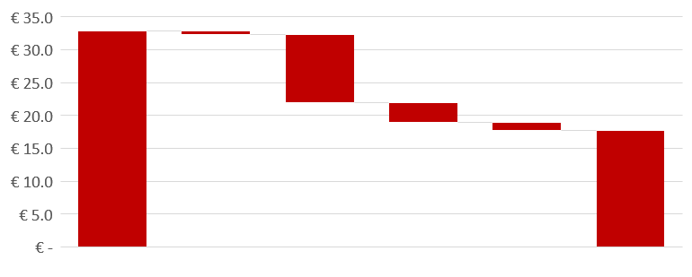
Industry interventions to close the true price gap
€ 0.70
€ 10.30
€ 22.00
€ 2.95
€ 0.55
€ 0.75
€ 8.25
€ 10.90
€ 9.50
Total true price gap
Water use efficiency
Address bonded labour
Towards living income and wages
Re-using denim textile from jeans
Target true price gap

Slide 35
Social and environmental costs per product per intervention (€ cents)
Example of business cases of interventions in agriculture
25
20
15
10
In this example, options are identified to reduce external costs for an agricultural product. As can be seen in the graphs interventions reducing environmental costs can at the same time reduce financial costs, thus increasing profits at grower level. The reduction of social cost requires an increase of the employee wages thus decreasing profits at grower level.
5
Social
Environmental
Profit & Loss per ha per intervention (€)
0
Average Farm
In-kind
Wages
Drip
Irrigation,
Bore Holes,
Rain Water
50%
IPM
Basic
Living
Wage
100%
IPM
Solar Powered GH
Target
Farm
Training
(I)
Gender Committee
Small
Scale
Solar
Training
(II)
More Effective
Gender
Committee
Sea Freight
Closed-loop hydroponics & coco peat
18.000
Profit
Loss
0

